Slide 1

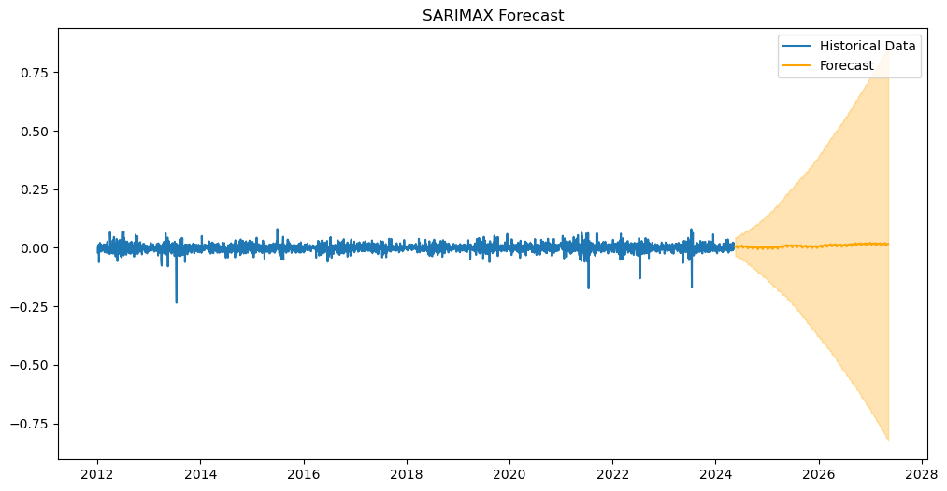
"Evaluating the Impact of Weather Conditions on Agricultural Stock Market Performance Using Time Series Forecasting""
ROSEMARY DEJESUS RAMIREZ CORDS
INTRODUCTION
RESULTS
Agriculture is a complex sector that involves different driving parameters (environmental, economic, and social). Agricultural production is now known to be highly sensitive to climate change (Easterling et al., 2007).
Climate change affects all agricultural sectors in a multitude of ways that vary from region to region, reducing the predictability of seasonal weather patterns and increasing the frequency and intensity of extreme weather events, such as floods, cyclones, and heatwaves (Food and Agriculture Organization, FAO, 2011).
OBJECTIVES
Examine the Impact of Weather Events on Stock Market Performance, analysing how some specific weather conditions influence in stock market returns over time.
Analyse the causal relationships between time series data points and external factors to identify key drivers of changes in the data, such as weather factors.
Test and compare different machine algorithm models to assess their accuracy in forecasting or capturing the underlying structure of the data.
METHODOLOGY AND MATERIALS
REFERENCES

